Slide 1
Intro to Data 3500

Slide 2
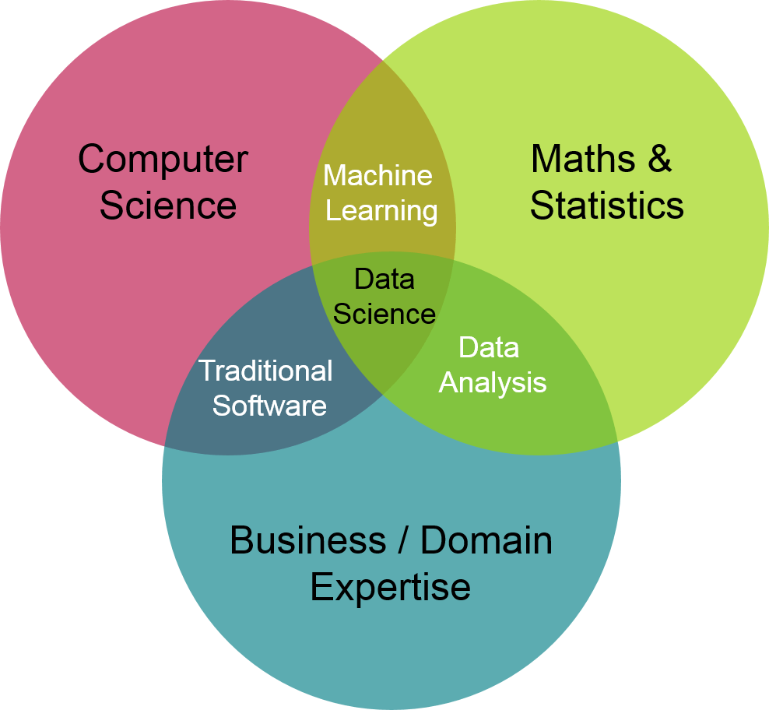

Slide 3
Why now?
We collect more data than ever before.
Suppose you buy a car from a dealership and fill out information.
That data is entered into databases from hundreds of dealerships.
It is easy to tie your car purchase to your social media and web browsing through your email address.
We now have a very complete picture of everyone who bought a car.
Age, likes, dislikes, friends, family
This information can be used to try to sell you specific insurance or advertise specific items to you.

Slide 4
The data science workflow
Collect data from many different sources.
Surveys, financial transactions, social media.
Data preparation.
Cleaning data, missing values, organize.
Explore and visualize.
Track changes in data over time, comparisons, outlier correction.
Experimentation and prediction.
Building a system to predict webpage usage, look at customer retention.

Slide 5
The roles of data science
Data Engineer
Data Analyst
Data Scientist
Machine Learning Scientist

Slide 6
Data Engineers
Information architects that control the flow of data.
Build data pipelines and storage solutions.
Maintain data access.
Focus on the first stage of the data science workflow.
Data collection and storage.
Data preparation.
Exploration and visualization.
Experimentation and prediction.

Slide 7
Data Engineering tools
SQL
Used to store and organize data.
Java, Scala, or Python
Programming languages to process data.
Shell
Command line to automate and run tasks.
Cloud computing
AWS, Azure, Google Cloud Platform.

Slide 8
Data Analyst
Perform simpler analyses that describe data.
Create reports and dashboards to summarize data.
Clean data for analysis.
Less programming and statistics than other roles.
Focus on the middle stages of the data science workflow.
Data collection and storage.
Data preparation.
Exploration and visualization.
Experimentation and prediction.

Slide 9
Data Analyst tools
SQL
Retrieve and aggregate data (obtain data from existing databases).
Spreadsheets (Excel or Google Sheets)
Simple analysis.
Business Intelligence Tools (Tableau, Power BI, Looker)
Dashboards and visualizations.
May use: Python or R
Clean and analyze data

Slide 10
Data Scientist
Strong background in statistics.
Run experiments and analyses for insight beyond just describing the data.
Traditional machine learning.
Focus on the last three stages of the data science workflow.
Data collection and storage.
Data preparation.
Exploration and visualization.
Experimentation and prediction.

Slide 11
Data Scientist tools
SQL
Retrieve and aggregate data.
Python and/or R
Data science libraries (ie. pandas)

Slide 12
Machine Learning Scientist
Predictions and extrapolations.
Use training data to classify larger more difficult data, such as images or creating chat bots.
Deep learning.
Image processing.
Natural language processing.
Focus on the last three stages of the data science workflow.
Data collection and storage.
Data preparation.
Exploration and visualization.
Experimentation and prediction (strong focus on prediction).

Slide 13
Machine Learning tools
Python and/or R
Machine learning libraries such as TensorFlow.

Slide 14
Recap
Data Engineer
Store and maintain data
SQL + Java/Scala/Python
Data Analyst
Visualize and describe data
SQL + BI Tools + Spreadsheets
Data Scientist
Gain insights from data
Python/R
Machine Learning Scientist
Predict with data
Python/R

Slide 15
Data collection and storage
Sources of data
Company data
Collected internally.
Helps make data driven decisions.
Open data
Free, available to anyone.
Can be used, shared, and built-on by anyone.

Slide 16
Company data
Web events
Survey data
Customer data
Logistics data
Financial transactions

Slide 17
Public data APIs
Application Programming Interface.
Request data over the internet from a third party.
Examples of Company APIs
Twitter
Wikipedia
Yahoo Finance
Many more

Slide 18
Public records
International organizations
World Bank, UN, WTO
National statistical offices
Censuses, surveys
Government agencies
Weather, environment, population
For the US, data.gov
For the EU, data.Europa.eu

Slide 19
Quantitative vs. qualitative data
Quantitative data
Deals with numbers.
Data can be measured.
Qualitative data
Deals with descriptions.
Data can be observed but not measured.

Slide 20
Quantitative vs. qualitative data
A refrigerator can contain both quantitative and qualitative measurements:
Quantitative
Is 60 inches tall.
Has 2 apples in it.
Costs $1000.
Qualitative
Is red.
Was built in Italy.
Smells like rotting food.

Slide 21
Other data types
Image data (pictures)
Text data (Yelp reviews)
Geospatial data (maps)
Network data (connections between people)
Can be a mix of quantitative and qualitative data.

Slide 22
Case study: Smart home
Data sources, information, and frequency
Weather conditions – National Weather Service API – 30 minutes
Tweets in your area – Twitter API – Real-time stream
Indoor temperature – Smart home thermostat – 5 minutes
Status of lights – Smart light bulbs – 1 minute
Status of locks – Smart door locks – 15 seconds
Energy consumption – Smart meter – 7 days
We must extract all of the data from each source, but none of the data is at the same frequency.

Slide 23
Transform
With all the data coming in, how do we keep it organized and easy to use?
Joining data sources into one data set.
Converting data structures to fit database schemas.
Removing irrelevant data (maybe the number of followers a Twitter user has).
Data preparation and exploration do not happen here.

Slide 24
Why prepare data?
Real-life data is messy
Preparation is done to prevent:
Errors
Incorrect results
Biasing algorithms

Slide 25
Let’s start cleaning
 | Sara | Lis | Hadrien | Lis
Age | “27” | “30” |  | 30
Size | 1.77 | 5.58 | 1.80 | 5.58
Country | “Belgium” | “USA” | “FR” | “America”

Slide 26
What is EDA?
Exploratory data analysis:
Exploring the data
Formulating hypotheses
Assessing characteristics
Visualizing

Slide 27
Let’s drive right in
Dataset 1 |  |  | Dataset 2 |  |  | Dataset 3 |  |  | Dataset 4
x | y |  | x | y |  | x | y |  | x | y
10.0 | 8.04 |  | 10.0 | 9.14 |  | 10.0 | 7.46 |  | 8.0 | 6.58
8.0 | 6.95 |  | 8.0 | 8.14 |  | 8.0 | 6.77 |  | 8.0 | 5.76
13.0 | 7.58 |  | 13.0 | 8.74 |  | 13.0 | 12.74 |  | 8.0 | 7.71
9.0 | 8.81 |  | 9.0 | 8.77 |  | 9.0 | 7.11 |  | 8.0 | 8.84
11.0 | 8.33 |  | 11.0 | 9.26 |  | 11.0 | 7.81 |  | 8.0 | 8.47
14.0 | 9.96 |  | 14.0 | 8.10 |  | 14.0 | 8.84 |  | 8.0 | 7.04
6.0 | 7.24 |  | 6.0 | 6.13 |  | 6.0 | 6.08 |  | 8.0 | 5.25
4.0 | 4.26 |  | 4.0 | 3.10 |  | 4.0 | 5.39 |  | 19.0 | 12.50
12.0 | 10.84 |  | 12.0 | 9.13 |  | 12.0 | 8.15 |  | 8.0 | 5.56
7.0 | 4.82 |  | 7.0 | 7.26 |  | 7.0 | 6.42 |  | 8.0 | 7.91
5.0 | 5.68 |  | 5.0 | 4.74 |  | 5.0 | 5.73 |  | 8.0 | 6.89

Slide 28
What can you tell about the data?
Probably almost nothing from just looking at it.
Surprise….
Identical mean and variance for x
Identical mean and variance for y
Identical correlation coefficient
Identical linear regression equation

Slide 29
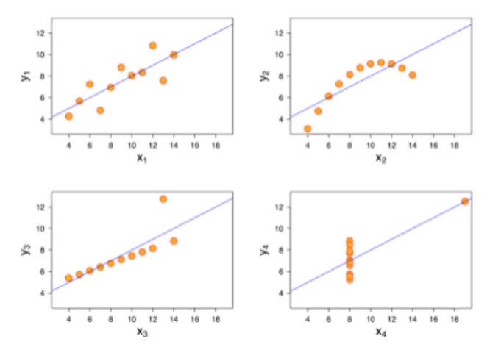
Are the value actually similar?

Slide 30
This course
The focus of this course will be…
Data collection
Data processing
Data exploration
Data visualization
Feature engineering

